Slide 1
Part I Syllabus – Fundamental Underlying Layers
Week​ | Date​ | Subject​
Week 1 | 9/Jan/2023​ | Introduction: Course Logistics and Internet History​
 | 11/Jan/2023​ | Layered Network Architecture​
Week 2 | 16/Jan/2023​ | Physical-layer Resilience
 | 18/Jan/2023​ | Data Link Layer: Flow Control​
Week 3 | 25/Jan/2023​ (no class on 23/Jan/2023, a holiday​) | Data Link Layer: Error Control​
Week 4 | 30/Jan/2023​ | Local Area Network: Introduction​
 | 01/Feb/2023​ | Local Area Network: Medium Access Control (MAC)​
Week 5 | 06/Feb/2023​ | Local Area Network: Ethernet​
 | 08/Feb/2023​ | Local Area Network: Ethernet Evolutions​
Week 6 | 13/Feb/2023​ | Wireless Local Area Network (WLAN): Overview and 802.11
 | 15/Feb/2023​ | First Part: WLAN’s Multi-Access Reservation Protocol (MARP); Second Part: A Brief Overview of Network Paradigms​
Week 7 | 20/Feb/2023 | Network Paradigms​: Circuit Switching versus Packet Switching
 | 22/Feb/2023 | Mobile Access Networks

Slide 2
Additional Materials
The related content about flow control talked today in https://eclass.teicrete.gr/modules/document/file.php/TP326/%CE%98%CE%B5%CF%89%CF%81%CE%AF%CE%B1%20(Lectures)/Computer_Networking_A_Top-Down_Approach.pdf is as follow:
stop-and-wait: Page 207- Page 218
sliding window: Page 218- Page 229
And here is another resource for your reference https://www.geeksforgeeks.org/flow-control-in-data-link-layer/
You can also find other video materials about
stop-and-wait Stop-and-Wait Protocol - YouTube
sliding window Sliding Window Protocol - YouTube

Slide 3

Drinking from Fire Hose

Slide 4

SC2008/CZ3006/CE3005
Lecture 3
Data Link Layer (DLL): Flow Control

Slide 5
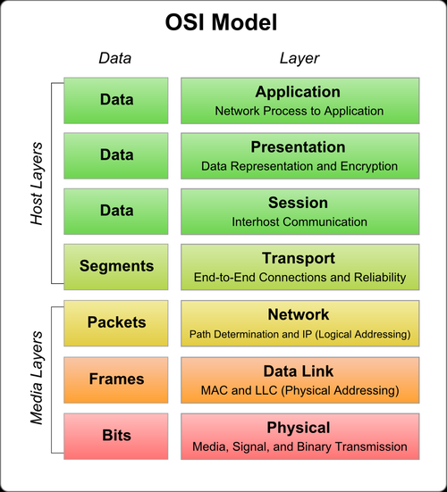
Contents
Data Link Layer Fundamentals
DLL Services
Framing mechanisms
Link configuration
Flow Control in DLL
Main purpose of flow control
Stop-and-wait mechanism
Sliding window mechanism
Encapsulation:
information gets bulkier and bulkier

Slide 6
Data Link Layer Fundamentals

Slide 7
Data Link Layer (DLL): Roles
Not Examinable
DLL Services
Framing: encapsulate each network-layer datagram within a link-layer frame before transmission over the link
Link Access: MAC protocol specifying the rules by which a frame is transmitted onto the link
Flow Control: control of data flow to ensure sender not overwhelm the receiver with data
Reliable Delivery: move each network-layer datagram across the link without error

Slide 8
Framing
Not Examinable
Byte Oriented (Character Oriented):
Information is framed into a fixed 8-bit basic unit.
Some of these basic units are used for signaling (protocol control).
Good solution when digital technology was in its primitive age (late 60s).
Bit Oriented (HDLC)
A flag is used to frame the bits sent.
Header/Trailer are used to describe the content of a frame. Frames may be used for control.
Used by all modern protocols (e.g., HDLC, PPP, Ethernet, etc).

Slide 9
Byte-Oriented Async. Transmission
Not Examinable
Pre-determined frame format
Start/stop bit
Parity check bit
Data bits
odd or even parity bit, if used
idle state
of line
unpredictable time interval between characters
5 to 8 data bits
0
. . .
1
start bit
start bit
stop bit(s) 1 or 2

Slide 10
Link Configuration/Access
Not Examinable
Objective: determine who gets to transmit at when on a link
Topology: physical arrangement of stations
Point-to-Point: pairs of hosts are directly connected
Broadcast: all stations share a single channel
Duplexity
Half Duplex: Only one party may transmit at a time.
Full Duplex: Allows simultaneous transmission and reception between two parties (e.g., two logical half-duplex channels on a single physical channel).

Slide 11
Topology
Not Examinable
Point-to-point:
Point-to-Multipoint (Broadcast):
T₁
T₂
T₃
T₄
All terminals share the same medium controlled by the primary station (mainframe)

Slide 12
Flow Control
All slides about Flow Control are Examinable.

Slide 13

Functions and Mechanisms
Examinable
Flow control
Ensuring that a transmitting station does not overwhelm a receiving station with data, i.e., buffers at the receiver do not get overflowed.
No frame error
Two Flow-Control Mechanisms
Stop-and-Wait
Sliding Window
A
B

Slide 14


Stop-and-Wait Flow Control
Examinable
②
A
frame
B
④
ACK
Operations:
① A packs binary information into a frame
② A sends the frame to B
③ A waits for an ACK
④ When B has received the frame, B sends an ACK
⑤ When A has received the ACK, A repeats ①

Slide 15

Frame Flow in Stop-and-Wait
Examinable
ACK1 means the receiver expects f₁, implying f₀ is received successfully
Binary sequence number is sufficient
f₀
f₁
f₀
sender
f₀
ACK1
f₁
ACK0
f₀
ACK1
…
receiver
time
f₀
f₁
f₀

Slide 16
Flow-Control Link Utilization
Examinable
the time that the link
carries useful information
the total time
T_{frame}
T_{cycle}
U
(Link Utilization)
=
=
T_{cycle} = T_{frame} + T_{prop} + T_{proc} + T_{ack} + T_{prop} + T_{proc}
T_{cycle}
T_{cycle}: Total time needed to send a frame
T_{proc}: Processing time
T_{frame}: Frame transmission time (i.e., to pump out a frame’s bits from your computer)
T_{ack}: ACK transmission time
T_{prop}: Signal Propagation delay
T_{frame}
T_{proc}
sender
time
receiver
T_{proc}

Slide 17
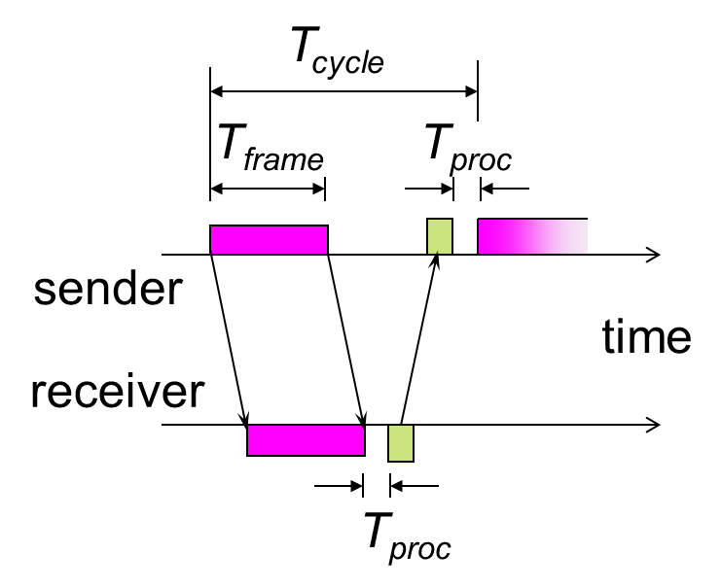
Link Utilization for Stop-and-Wait
Examinable
Assumptions
Input is saturated
No error
Ignoring T_{ack} & T_{proc}
We get:
T_{cycle} = T_{frame} + 2 T_{prop}
Then:
U = T_{frame} / (T_{frame} + 2 T_{prop})
= 1 / (1+2a)
where:
we define a = T_{prop} / T_{frame}
Parameter ‘a’ is called Normalized Propagation Delay

Slide 18
Example
Examinable
A communication link exists between two nodes A and B. The transmission rate on the link is 2.4 Mbps. The distance between A and B is 50 km and the signal velocity is 2x10⁸ m/s. The frame length is 300 bytes. No frame error. Calculate the link unitization for the stop-&-wait flow control mechanism.
A
B
Here T_{p} and T_{f} are short for
T_{prop} and T_{frame}, respectively.
R= 2.4 Mbps, L=300 bytes =2400bits
D=50km, v = 2x10⁸ m/s
U=1/(1+2a)
a = T_{p}/T_{f}
T_{p}=D/V=5x10⁴/2x10⁸ = 250 μs
U=1/(1+2*0.25)
= 2/3
a = 0.25
T_{f}=L/R=2400/2.4x10⁶ = 1000 μs
μs means microsecond; i.e., 10⁻⁶ seconds.

Slide 19
Stop-and-Wait: Disadvantages
Examinable
If frame or ACK is lost, long waiting time is expected
To fix this, use a TIMEOUT control in the sender
If the normalized propagation delay is long, the sender must wait a long time before it can perform the next transmission.
The link utilization is low.
To fix this, use Buffers at the sender/receiver (sliding window operation). This will improve the numerator. Note that the denominator 1+2a cannot be improved.

Slide 20
Sliding Window Flow Control
Examinable
Allows multiple frames to be in transit.
Sender and Receiver have buffer N long.
Sender can send up to N frames without receiving ACKs.
Each frame is numbered.
ACK includes number of next expected frame.
Sequence number bounded by field size (k bits)
Frames are numbered modulo 2^{k}
Sequence number [0, 2^{k}-1]

Slide 21
Sliding Window Operations
Examinable
Sender
Move lower bound when frames sent
Move upper bound when acks received
Receiver
Move lower bound when frames received
Move upper bound when acks sent

Slide 22
Sliding Window Operations
Examinable
Sender maintains a window, containing frame numbers that can be transmitted.
Sender window shrinks from trailing edge (left side) as frames are sent.
Receiver maintains a window as well, its window shrinks from trailing edge as frames are received.
Receiver’s window expands from the leading edge (right side) as ACKs are sent.
Sender’s window expands from the leading edge as ACKs are received.

Slide 23
Sliding Window: Example
Examinable

Slide 24
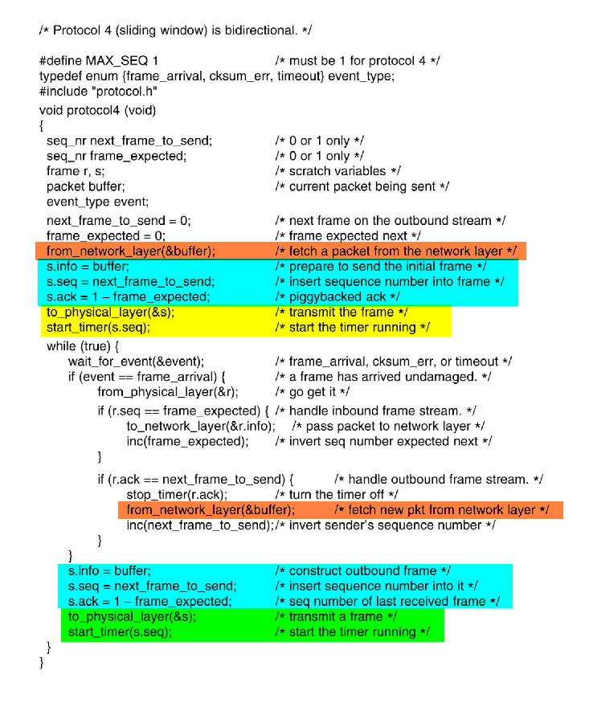
Sliding Window Algorithm
Not Examinable

Slide 25
Window Size Consideration
Examinable
Say, window size, N = 3
with k=1 bit sequence number
0 1 0 1 0 1 0 1
Sender: Do you ask for a retransmission of the transmitted frame or a new frame?
sender
0 1 0
ack1
receiver
Receiver: Is it a retransmission or a new frame?
 Is the second 0 a new frame or the retransmitted frame?
 Which frame is to be transmitted next after receiving ack1?

Slide 26
Examinable
Based on the previous slide, for window size N and k bits sequence number, we need
N ≤ 2^{k}

Slide 27
Sliding Window: Other Features
Examinable
Receiver can acknowledge frames without permitting further transmission (by sending ‘Receive Not Ready’, RNR frame). Receiver must send a normal acknowledgement to resume.
ACK can be piggybacked on the data frames in the reverse direction.
sender
F0
F1
RNR2
receiver
sender
F0
F1
F0+ACK2
receiver

Slide 28
Sliding Window: Performance
Examinable
Performance depends upon
Parameter a, and
Window size, N.
Assumption: T_{ack} and T_{proc} are negligible.
Frame transmission time = 1 (normalized to itself)
Normalized propagation delay (one-way) = a
We need to consider two cases:
N ≥ 2a +1: Station can transmit continuously without exhausting its window → U = 1.0
N < 2a +1: Station’s window is exhausted at t = N, and the station cannot send additional frames until t = 2a + 1, → U = N/(1 + 2a)
(assume error-free operation):

Slide 29
Case I: N ≥ 2a +1 [U=1]
Examinable
t = 0
A
B
t = 1
A
Frame 1
B
t = 2
A
Frame 2
Frame 1
B
. . .
t = a
A
Frame a
Frame a-1
Frame 2
Frame 1
B
. . .
t = a+1
A
Frame a+1
Frame a
Frame 3
Frame 2
B
. . .
A
t = 2a+1
A
Frame 2a+1
Frame 2a
Frame a+3
Frame a+2
B
A

Slide 30
Case II: N < 2a +1 [U=N/(1+2a) ]
Examinable
t = 0
A
B
t = 1
A
Frame 1
B
. . .
t = a
A
Frame a
Frame a-1
Frame 2
Frame 1
B
. . .
t = a+1
A
Frame a+1
Frame a
Frame 3
Frame 2
B
. . .
A
Frame N-a+2
Frame N-a+1
t = N
A
Frame N
Frame N-1
B
A
no tx (ie. wastage)
. . .
t = 2a+1
A
Frame N
Frame a+2
B
A

Slide 31
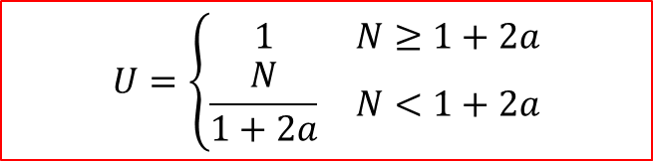
Sliding Window: Performance
Examinable
Window Size = N
T_{useful} = N*T_{frame}
T_{cycle} = T_{frame}+2*T_{prop}
T_{useful}
$$U=\left\{\begin{matrix}1 & N≥1+2a \\ \frac{N}{1+2a} & N<1+2a\end{matrix}\right.$$
T_{cycle}
0 1
2 3
0 1
sender
ACK1
ACK3
ACK0
0 1
ACK2
2 3
receiver
time
0 1
2 3

Slide 32
Flow Control: Link Utilization
Examinable
N=1
N=7
N=127
Stop-and-Wait
Link Utilization versus a

Slide 33
Learning Objectives
Data Link Layer Fundamentals
To understand its (four) main functions
Flow Control
To understand its main purpose
Stop-and-Wait Flow-Control Mechanism
Operational protocol
Link utilization calculation
Sliding Window Flow-Control Mechanism
Operational protocol
Window size determination
Link utilization calculation (two cases)

